Slide 1
Toronto Crime Data Analysis Using Unsupervised Learning
Presented by: Ganesh Rajasekar, Kunal Taneja, Prateek Gulati, Anmol Sharan Nagi
Faculty of Engineering

Slide 2
PROBLEM STATEMENT
Toronto police launched a public safety data portal to increase transparency between the public and officers by allowing users to look at open data about different crimes.
Our study aims at identifying violent and non-violent neighbourhoods in the city of Toronto, while providing a better visualization for the public.
We intend to perform data analysis to find out what crimes occurs in what time of the day and the geographic location associated with crime. These findings would be performed using different clustering techniques.

Slide 3
LITERATURE REVIEW
Alkhaibari, Adel Ali, and Ping-Tsai Chung. "Cluster analysis for reducing city crime rates." 2017 IEEE Long Island Systems, Applications and Technology Conference (LISAT). IEEE, 2017.
uses different clustering algorithms such as K-Means clustering and agglomerative clustering which were applied to the New York Police Department (NYPD), for analysing the location of the crime.
Several visualization techniques were used to represent the clusters’ profiles.
The study revealed that K-Means algorithm is the best clustering algorithm and that good features are paramount to ensuring that the models are beneficial.
Ding, Chris, and Xiaofeng He. "K-means clustering via principal component analysis." Proceedings of the twenty-first international conference on Machine learning. ACM, 2004.
Explains how applying PCA prior to K-means clustering can help in getting better clusters and also improved running times.

Slide 4
LITERATURE REVIEW
Kou, Gang, Yi Peng, and Guoxun Wang. "Evaluation of clustering algorithms for financial risk analysis using MCDM methods." Information Sciences 275 (2014): 1-12.
This paper proposes an MCDM-based approach to evaluate the clustering results in financial risk analysis.
Evaluation of clustering algorithms involves more than one criterion, such as entropy, Dunn’s index, and computation time, it can also be modelled as a MCDM problem.
chooses six clustering algorithms, eleven validity measures, and three MCDM methods to validate the evaluation approach.
The results show that no algorithm can achieve the best performance on all measurements for any data set and it is necessary to utilize more than one single performance measure to evaluate clustering algorithms.
The rankings generated by the three MCDM methods agree on the top ranked clustering algorithms in general and provide a useful tool to evaluate clustering algorithms based on a combination of validity measures.
MCDM - multiple criteria decision making problem

Slide 5
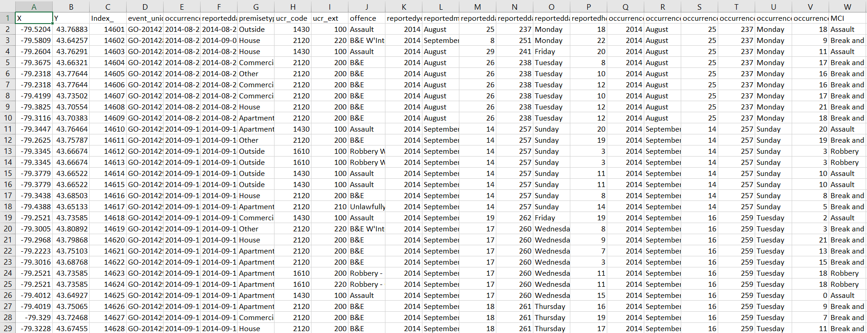
ABOUT DATA
Source: http://data.torontopolice.on.ca/datasets/mci-2014-to-2017
Samples: 131073 entries
Features: 29 parameters
Labels : N/A
Span of data: 2000 – 2017
Reports Major crime indicators along with their place and time and unique ID of occurrences.

Slide 6
DATA EXPLORATION
Duplicate event_unique_ids deleted: 17165
Redundant and Irrelevant features dropped: 16
Reported Crimes between years: 2000 – 2017
Largest number of entries found in years: 2015 – 2017
Separate analysis done on years 2015, 2016, 2017

Slide 7
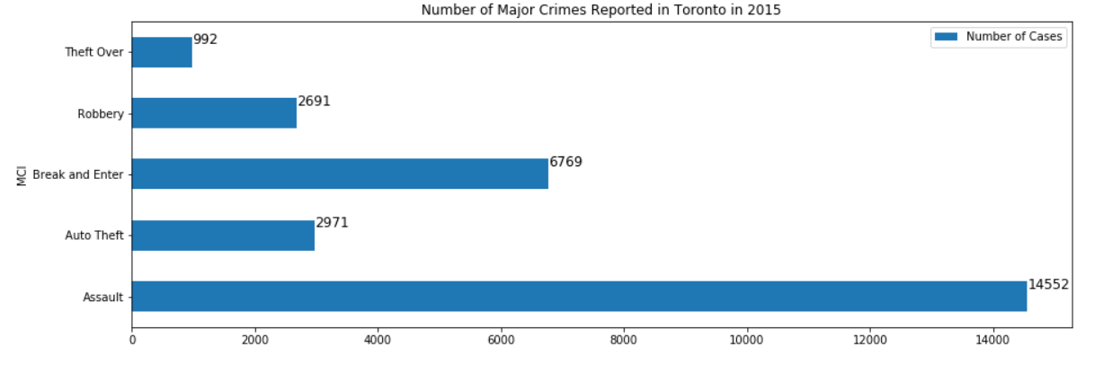
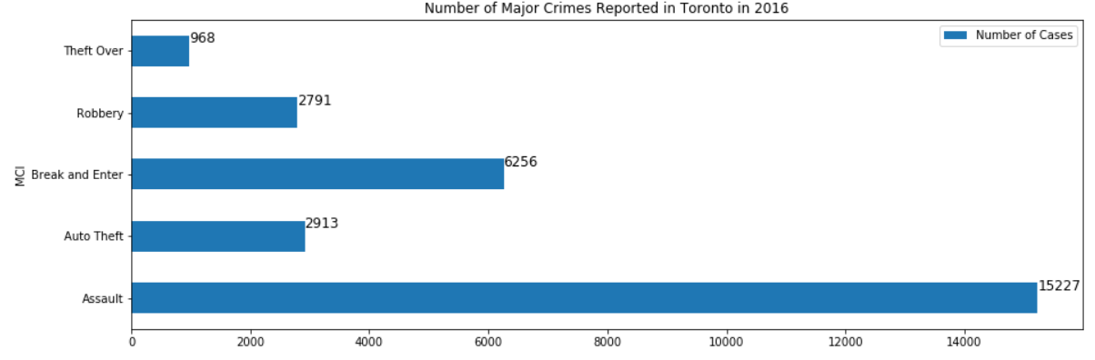
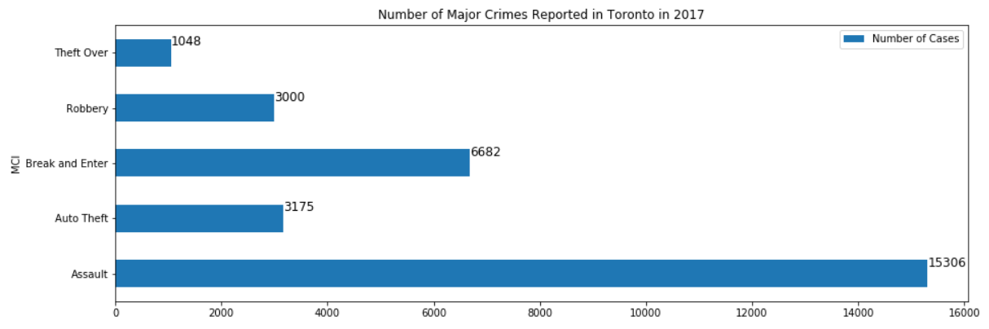
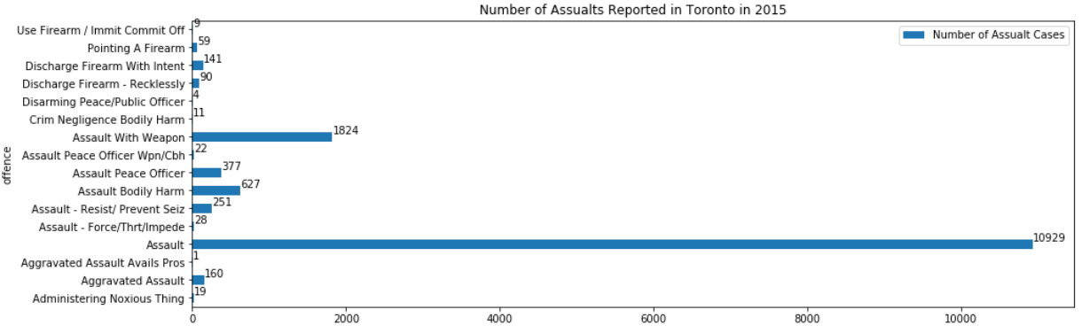
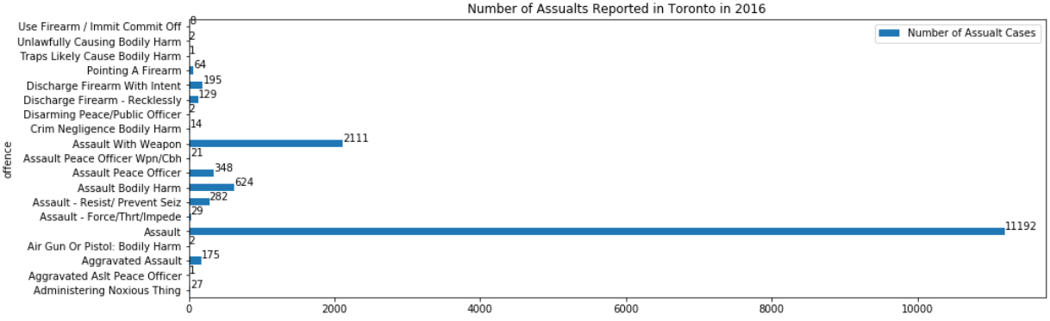
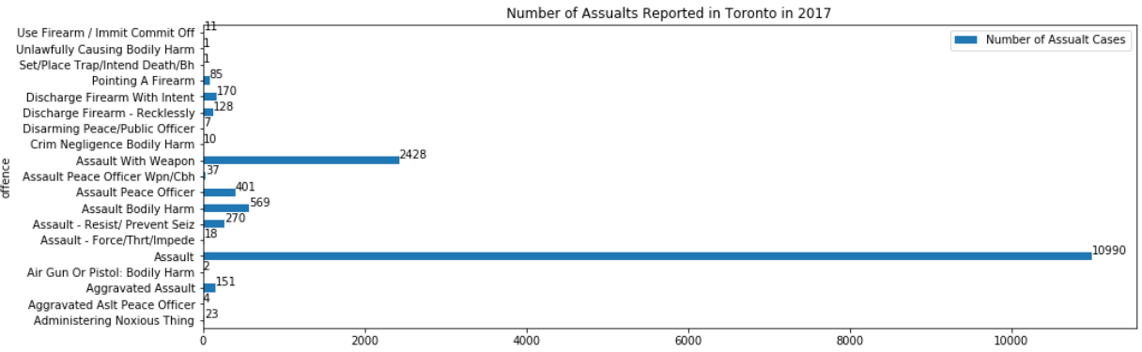
MAJOR CRIMES OCCURENCES IN 2015, 2016, 2017

Slide 8
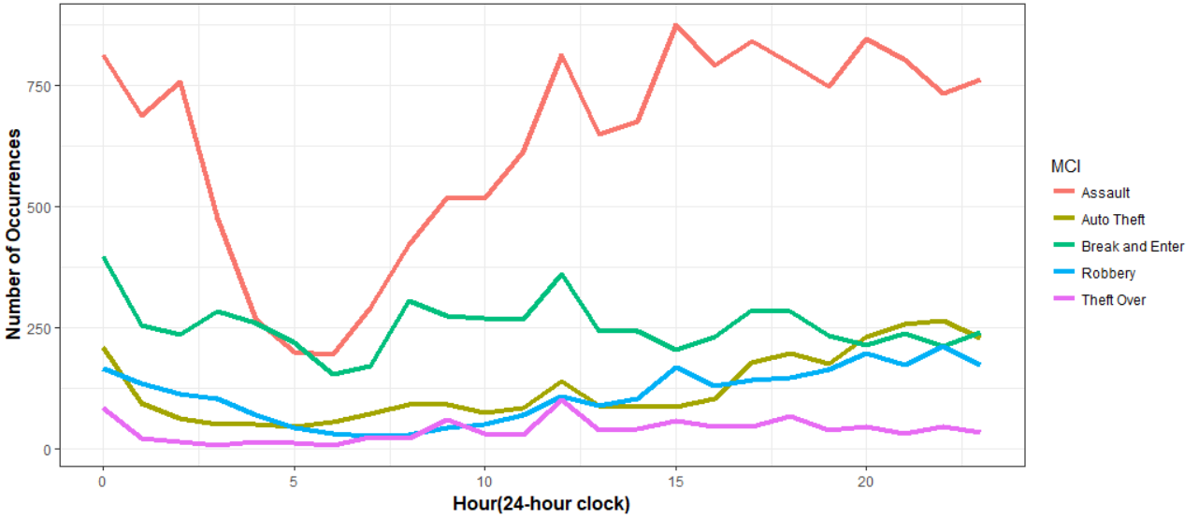
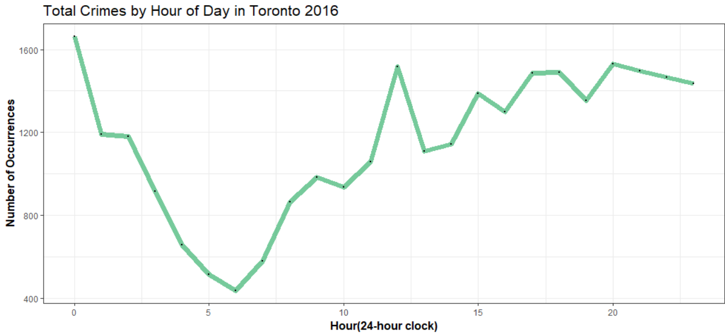
ANALYSING CRIME OCCURENCES BASED ON DAY HOURS.
Worst Hour : Around Midnight
Assault: Most Occurrence, sharp dip in early morning hours. Most Frequent during midnight and evenings.

Slide 9
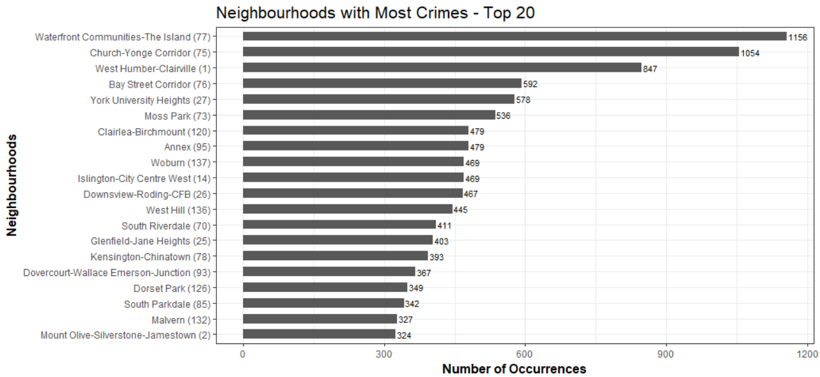

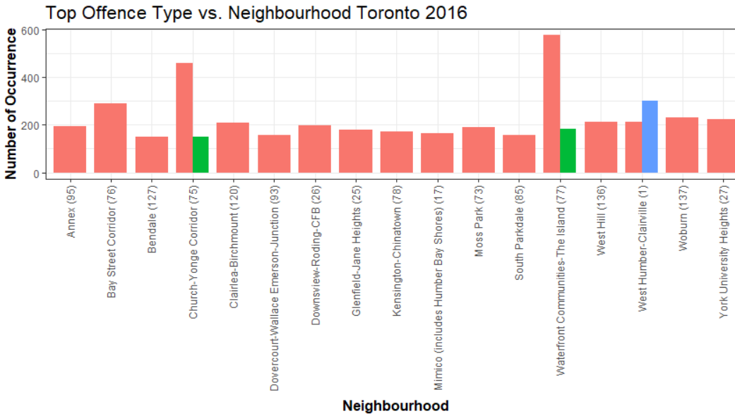
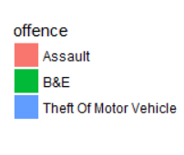
ANALYSING CRIME OCCURENCES BASED ON NEIGHBOURHOOD
Waterfront, most violent neighbourhood followed by Church-Yonge.
Assaults have maximum contribution among all neighbourhoods followed by break and enter.

Slide 10
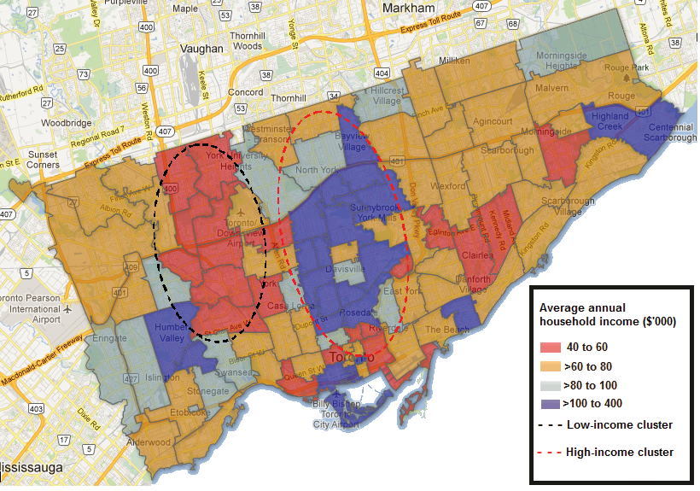

Unsupervised Learning
Applying and Comparing Different Clustering Techniques on Toronto Crime Dataset
Image Source :http://jcda.ca/article/e3

Slide 11
K-MEANS CLUSTERING
K-MEANS CLUSTERING
Goal: To group Toronto neighbourhoods based on the Major Crime indicators as violent and non-violent.
K-Means: One of most powerful and easy to implement unsupervised clustering technique.
K-Means clustering assigns a cluster to each neighbourhood.
It partitions neighbourhoods into k clusters such that each neighbourhood belongs to the cluster with the nearest mean, serving as a prototype of the cluster.
Challenge: Deciding value of k?
Can be evaluated based on application domain.
Elbow method and silhouette score.

Slide 12
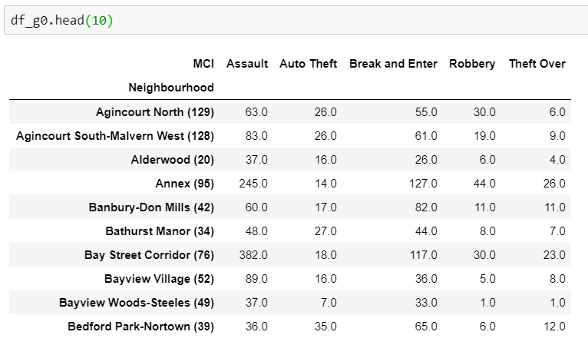
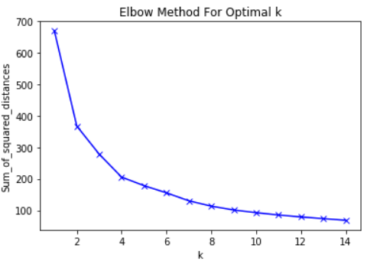
K-MEANS CLUSTERING: 2015 criminal records.
Selecting value of K based on Elbow Method:
Major crime indicators are grouped based on the neighbourhoods and then elbow method is performed to get the value of k.
No clear elbow: k = 2 or 3.

Slide 13
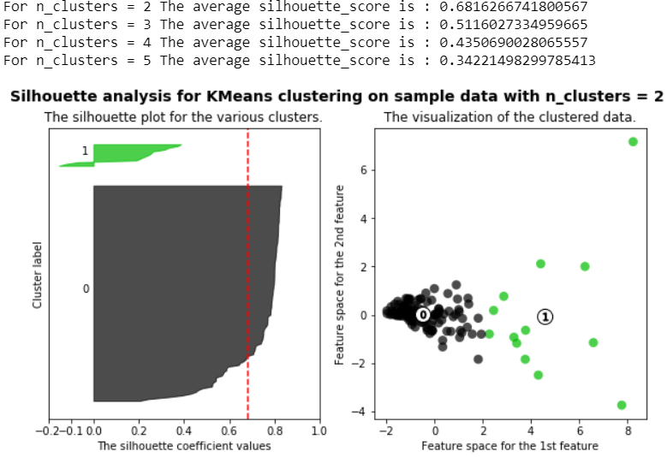
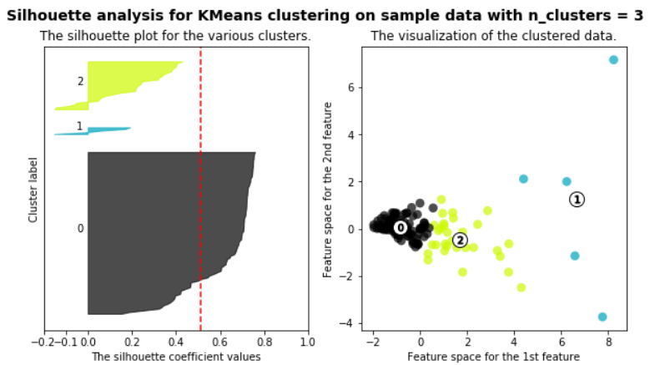
K-MEANS CLUSTERING: 2015 criminal records.
Selecting value of k based on Silhouette Analysis.
As k=2 has the highest average silhouette score we select k=2 for k-means clustering on crime data.

Slide 14
K-MEANS CLUSTERING: 2015 criminal records.
Applying PCA prior to clustering:
PCA captures the features with highest point of variance and tries to reduce the dimensionality by extracting only these features.
Moreover, it makes easier to visualise the clustering results on 2D planes.
3 principal components selected based on highest eigenvalues such maximum variance is captured.
Results obtained after clustering are plotted along 2 principal components.
Clustering results are compared with and without PCA.

Slide 15
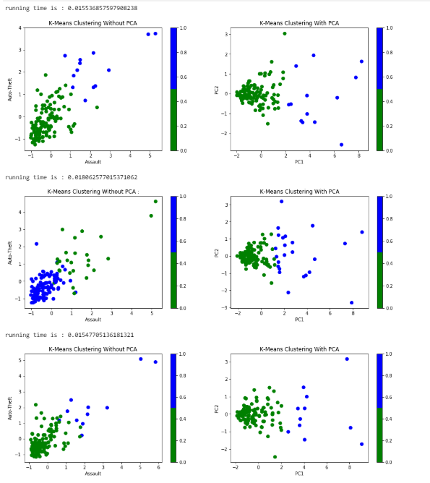
K-MEANS CLUSTERING: results for 2015, 2016, 2017 records.
VALIDATION | 2015 | 2016 | 2017
Run Time (s) | 0.0155 | 0.0181 | 0.0154
Dunn Index | 0.0883 | 0.05145 | 0.09171
Calinski Harabaz Score | 121.415 | 110.402 | 116.702
Davis Bouldin Score | 0.7989 | 0.9051 | 0.7831
Silhoutette Score | 0.6816 | 0.5870 | 0.7031

Slide 16
HEIRARCHICAL CLUSTERING
Hierarchical clustering: builds nested clusters by merging or splitting them successively.
Hierarchy of clusters represented as dendrograms (tree structures).
The root of the tree is the unique cluster that gathers all the samples, the leaves being the clusters with only one sample.
No need to select number of clusters prior to clustering.
Makes clusters (by merging) based on linkage strategy.
Ward linkage strategy used to form hierarchical clusters.

Slide 17
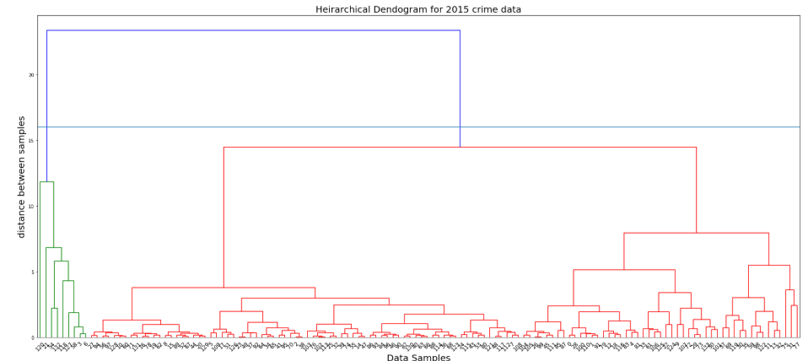
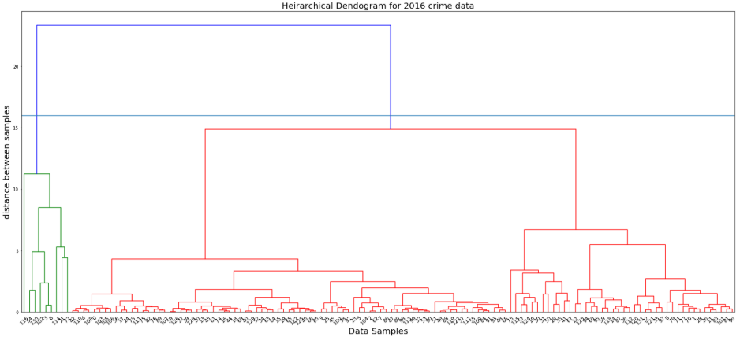
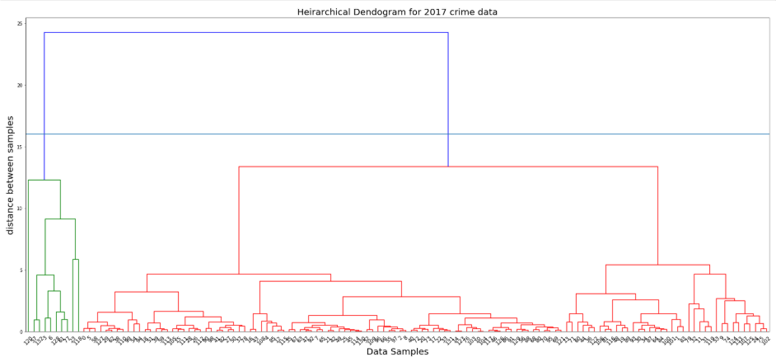
HEIRARCHICAL CLUSTERING: DENDOGRAMS (2015-2017)

Slide 18
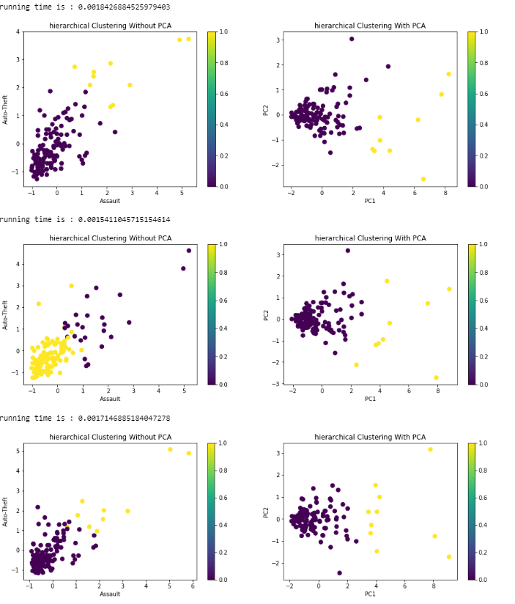
HEIRARCHICAL CLUSTERING: Results (2015-2017)
Validation | 2015 | 2016 | 2017
Run Time (s) | 0.0018 | 0.0015 | 0.0017
Dunn Index | 0.1200 | 0.1515 | 0.1501
Calinski Harabaz Score | 100.990 | 101.044 | 115.595
Davis Bouldin Score | 0.7667 | 0.8153 | 0.7755
Silhoutette Score | 0.7033 | 0.7054 | 0.7124

Slide 19
DBSCAN CLUSTERING
DBSCAN: views clusters as areas of high density separated by areas of low density.
DBSCAN groups together points that are close to each other based on a distance measurement (usually Euclidean distance) and a minimum number of points.
Marks as outliers the points that are in low-density regions.
Parameters:
eps: the minimum distance between two points. It means that if the distance between two points is lower or equal to this value (eps), these points are considered neighbours.
minPoints: the minimum number of points to form a dense region..
eps =1.2 minPoints = 4

Slide 20
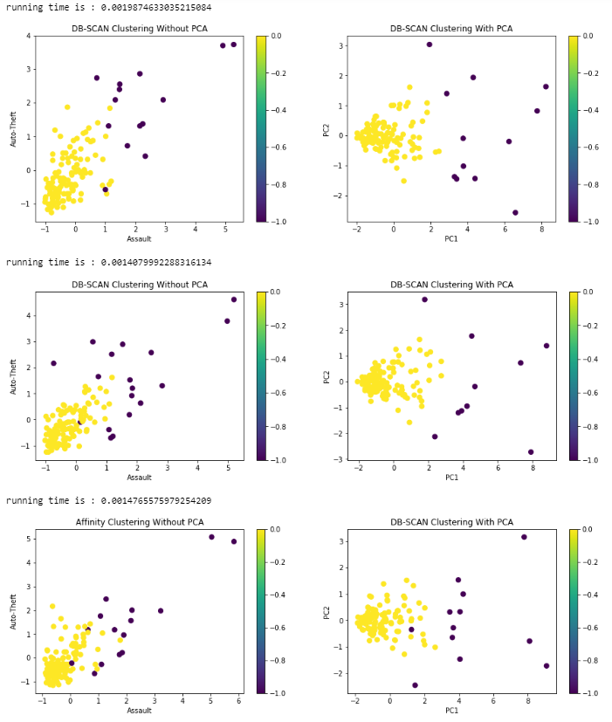
DBSCAN CLUSTERING: results (2015-2017)
Validation | 2015 | 2016 | 2017
Run Time (s) | 0.0019 | 0.0014 | 0.0014
Dunn Index | 0.1200 | 0.1515 | 0.1195
Calinski Harabaz Score | 115.29 | 95.52 | 102.85
Davis Bouldin Score | 0.8348 | 0.8833 | 0.8677
Silhoutette Score | 0.6915 | 0.6931 | 0.6832

Slide 21
COMPARISON BETWEEN METRICS
Score | Clustering Technique (#1) | Clustering Technique (#2)
Run Time (s) | DBSCAN | Hierarchical
Dunn Index | Hierarchical | DBSCAN
Calinski Harabaz Score | K-Means | Hierarchical
Silhouette Score | Hierarchical | DB-SCAN
Davis Bouldin Score | Hierarchical | K-MEANS
Low is better: Running Time & Davis Bouldin Score
High is better: Dunn Index, Calinski Harabaz Score, Silhouette Score
In the above analysis we can see that Hierarchical Clustering is the most apt choice in all the scores except Calinski Harbaz score.

Slide 22
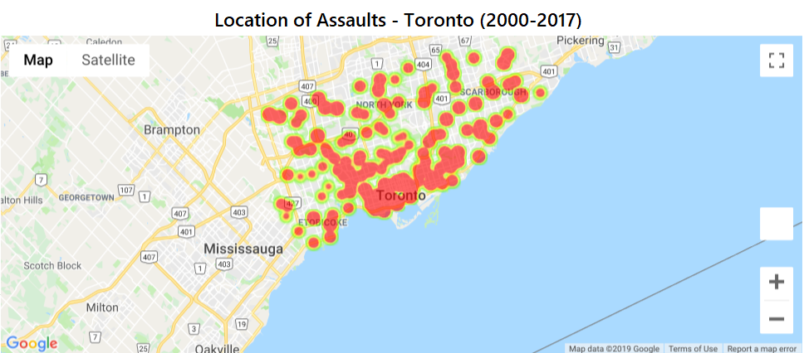
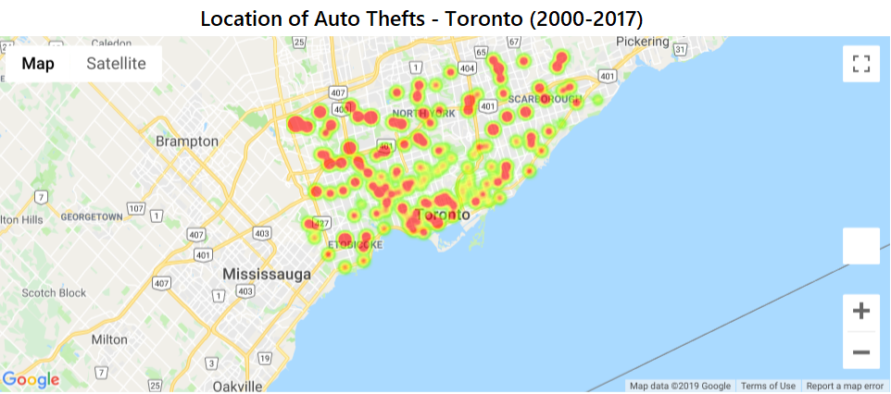
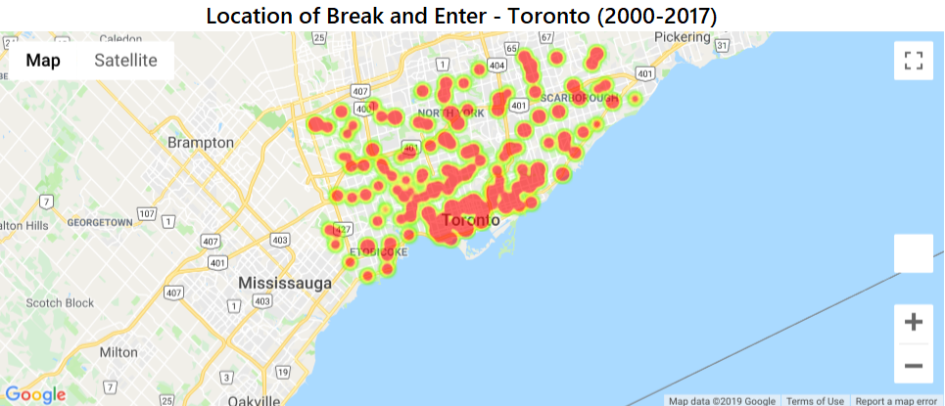
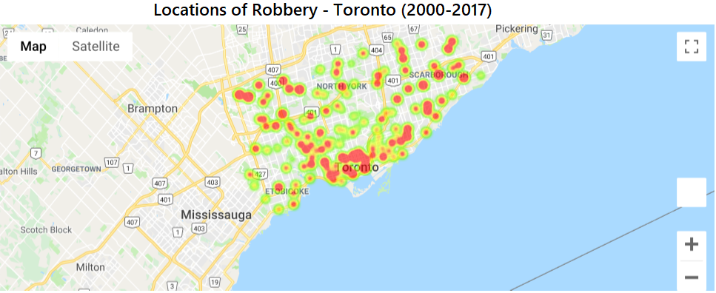
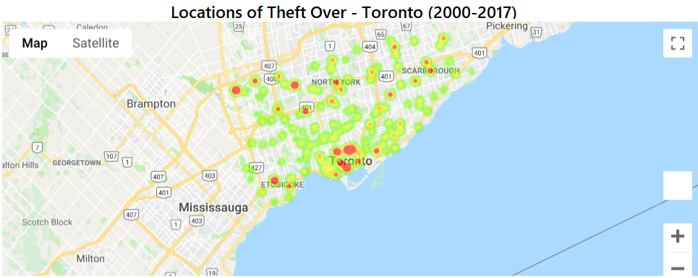
VISUALISING MAJOR CRIME INDICATORS ON GOOGLE MAPS

Slide 23
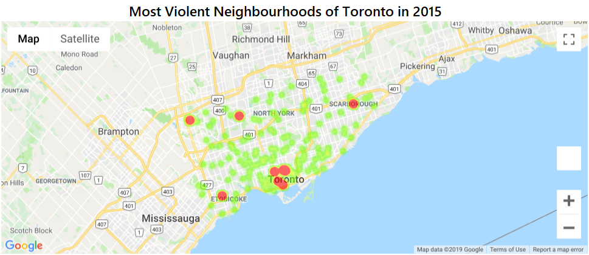
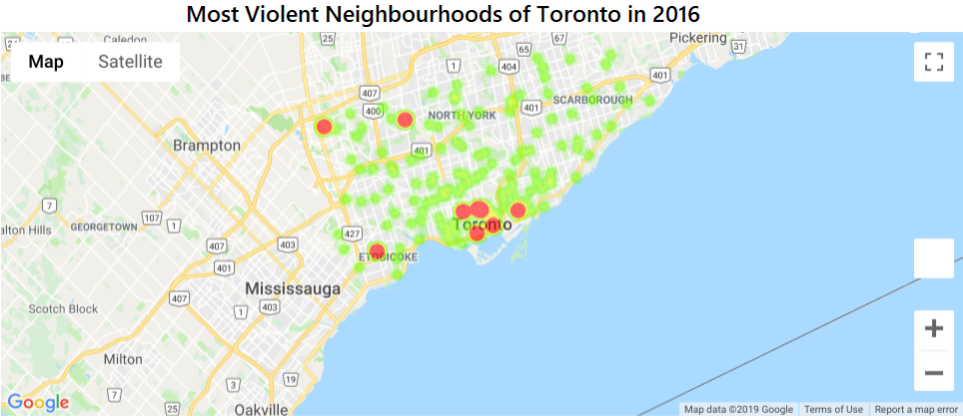
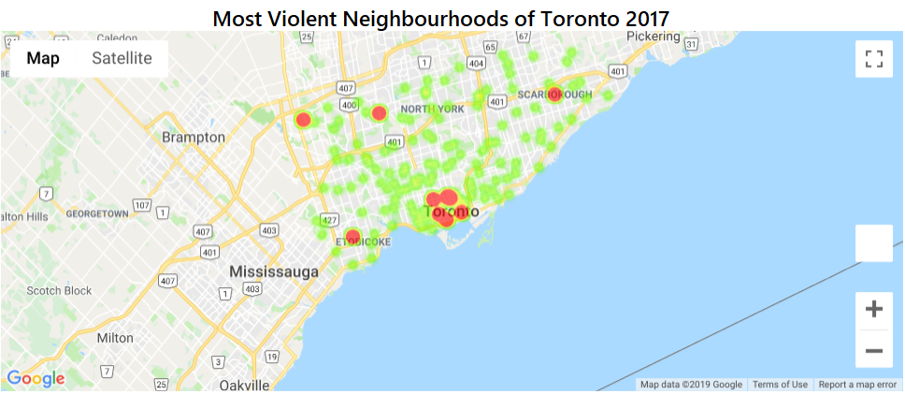
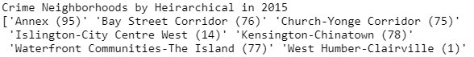
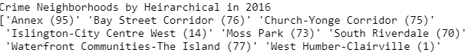
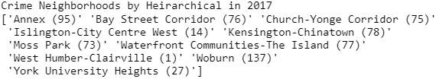
Visualising Most Violent Neighbourhoods of Toronto (2015-2017)

Slide 24
Conclusion and Future score
Based on the results got for most violent neighbourhoods we can find the reasons and map relationships for the violent activities.
We can scale our study on province level and group violent and non violent neighbourhoods for other cities of Ontario to get a broader image of criminal activities.

Slide 25
REFERENCES
Alkhaibari, Adel Ali, and Ping-Tsai Chung. "Cluster analysis for reducing city crime rates." 2017 IEEE Long Island Systems, Applications and Technology Conference (LISAT). IEEE, 2017.
Ding, Chris, and Xiaofeng He. "K-means clustering via principal component analysis." Proceedings of the twenty-first international conference on Machine learning. ACM, 2004.
Kou, Gang, Yi Peng, and Guoxun Wang. "Evaluation of clustering algorithms for financial risk analysis using MCDM methods." Information Sciences 275 (2014): 1-12.
Fraley, Chris, and Adrian E. Raftery. "How many clusters? Which clustering method? Answers via model-based cluster analysis." The computer journal 41.8 (1998): 578-588.
Bidoki, S.M., Mahmoudi-Kohan, N., Sadreddini, M.H., Jahromi, M.Z. and Moghaddam, M.P., 2010, April. Evaluating different clustering techniques for electricity customer classification. In IEEE PES T&D 2010 (pp. 1-5). IEEE.
Pham, Duc Truong, Stefan S. Dimov, and Chi D. Nguyen. "Selection of K in K-means clustering." Proceedings of the Institution of Mechanical Engineers, Part C: Journal of Mechanical Engineering Science 219.1 (2005): 103-119.

Slide 26
THANK YOU QUESTIONS?

